Slide 1


ENTERPRISE API
July 2021
Lester Henderson, Solutions Architect

Slide 2

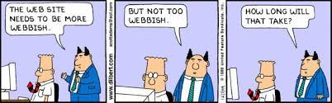
Architecture Point of View

Slide 3

Architecture Point of View
Every Architecture has its positives and negatives. Architecture is about finding the right balance across many areas including risk, security, performance, maintainability, scale, cost and so forth.
Notes:
In addition, every technology domain tends to see architecture through their lens
Data
Network
Servers
Business

Slide 4

Why have an Enterprise API Strategy?
CAUTION
Tooling for building APIs makes it easy for APIs to become unwieldly to manage.
Most modern products have some API capabilities, which can impact how to design overall capabilities.
Technology is evolving at an even more aggressive rate.
There is no one size fits all.
There can be disagreements within the technology industry how to interpret or implement technology standards

Slide 5
Why have an Enterprise API Strategy?
There are things that can be retrofitted after the fact
However, as an organization grows it becomes harder and harder to do this.
“We will do that later” – then later never comes.
Building solutions that will grow well with the organization.
Steps can be made today to minimize technology disruption in the future.
As an organization grows, the need for a clear path and strategy becomes more necessary to reduce churn, technical debt and overlapping API needs between domains.
An API strategy in place assists if an acquisition is performed as the domain modeling becomes a key way to understand how to integrate with acquiring or aligning technology.
External APIs (Consumer) must be well thought out and planned to minimize impact to customer base.

Slide 6

Why have an Enterprise API Strategy?
Typical Enterprise Needs
Scale
Business Continuity
Security
Rapid Deployment
Performant
Traceability
Composable
Loosely Coupled
Multi-Location Hosting
Discoverability
Versioning
Consistency
Handle evolving security needs
Handle both internal and external consumers
The ultimate goal is to be able to move quickly,
Provide capabilities to the business,
Increase customer satisfaction,
Without impacting the business or the consumer
Notes:
Sound person

Slide 7
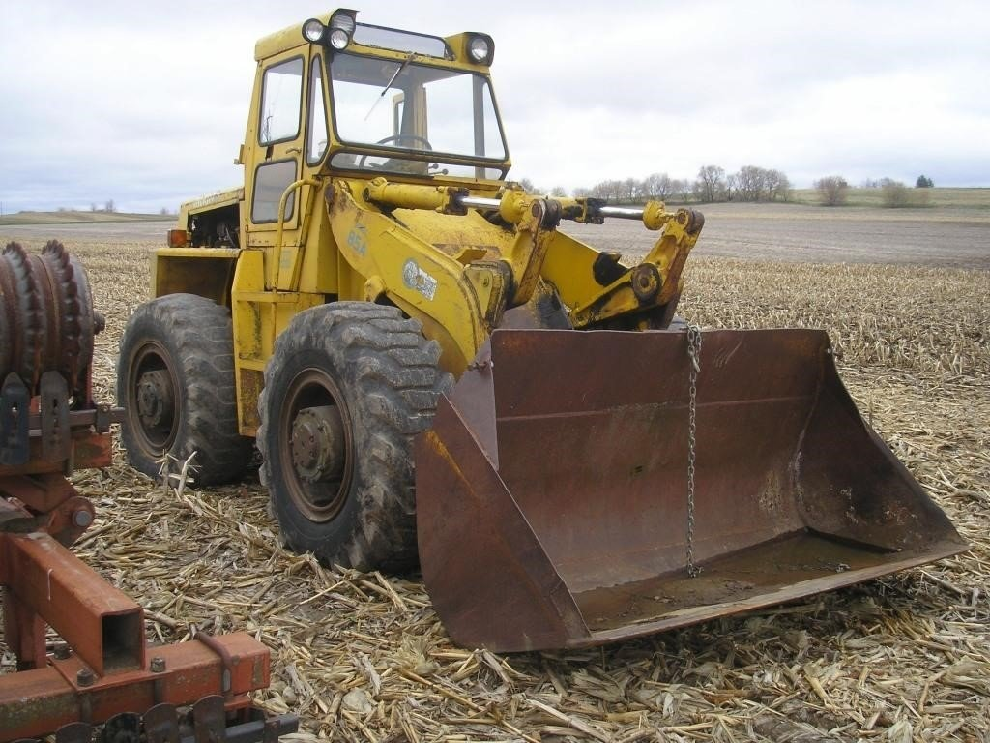
Architecture Point of View
Cohesive / Sympathetic Architecture
Do not re-invent the wheel.
Take advantage
Of best practices and standards that exist.
Let the unicorns invent, we will take advantage
Of what they have done.
Our focus is not technology per sec, but our
Business goals. We just happen to use technology
Notes:
Sunstate – Rental People you can count on, A better way to rent equipment,
Sunstate wants to be the best equipment rental business – technology is used to get to that goal

Slide 8

Architecture Point of View
We must know where we are
We have to know where we are going

Slide 9
Where are we?
Great Start on an API strategy
Sunstate has developed, used software with an integration mindset
Sunstate has built API layers for several of its vertical slices
Sunstate has adopted an Agile software development lifecycle
Sunstate has begun the practice of doing domain modeling by identifying domain/pod areas of the business
Sunstate has started an Enterprise Data Management Strategy

Slide 10
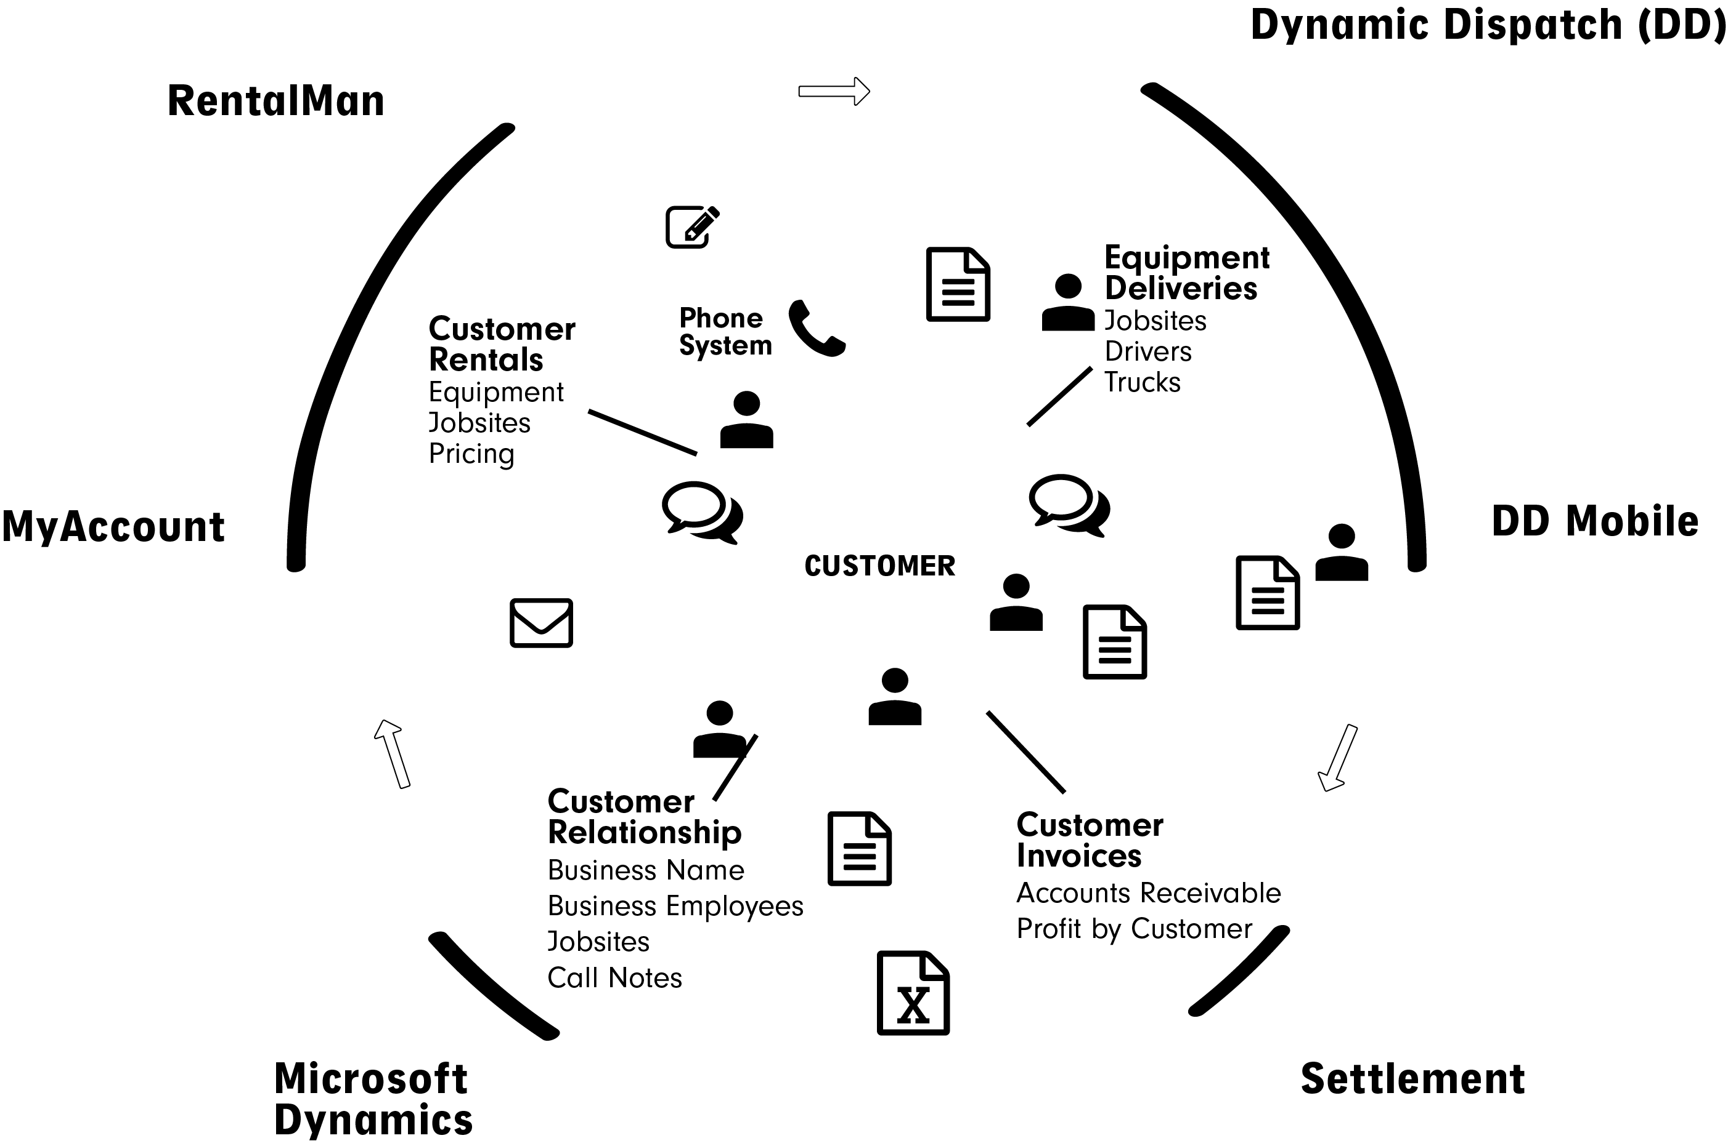
Where are we - Domains

Slide 11






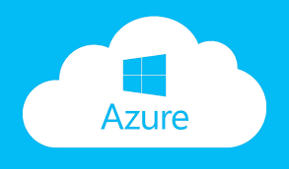


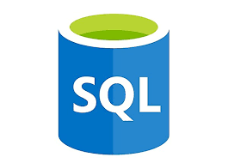


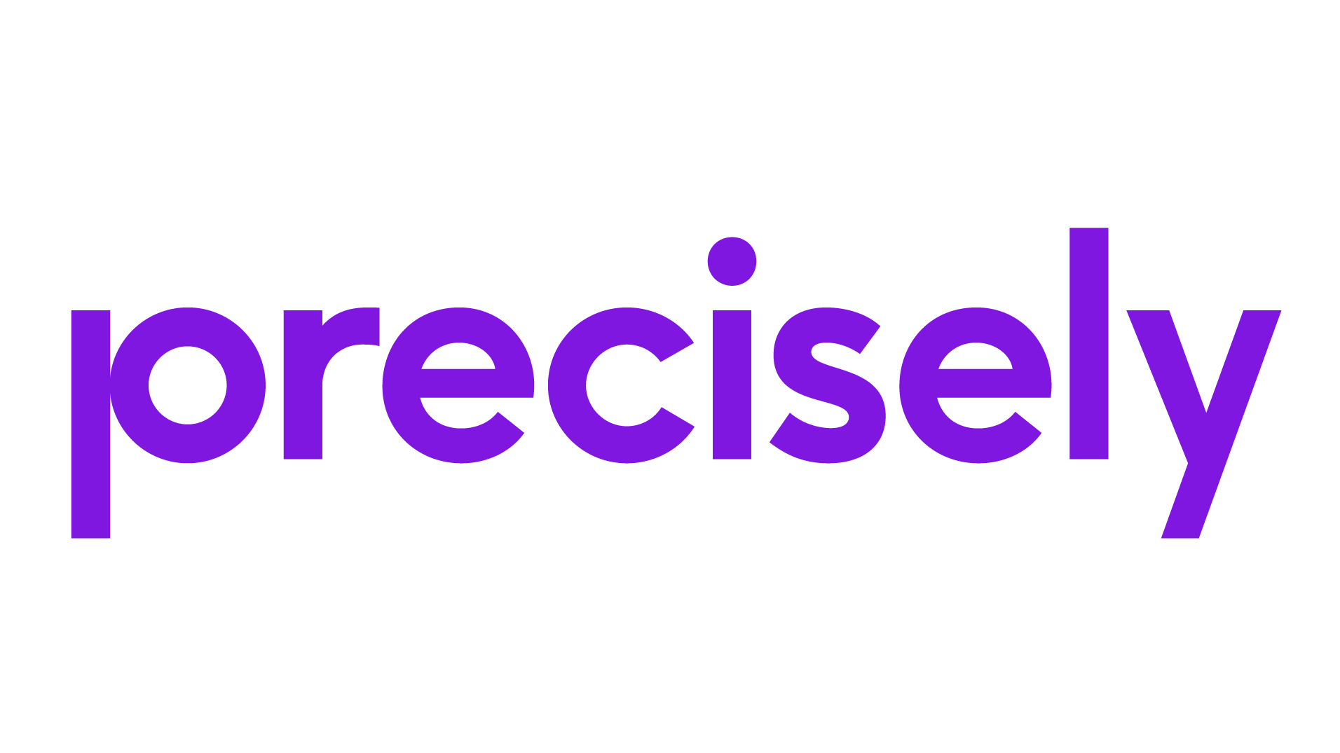







DATA LAYERS
Where are we – Enterprise Data
ENTERPRISE DATA ARCHITECTURE
DATA ADMINISTRATION
SUNSTATE EQUIPMENT ENTERPRISE DATA LIBRARY (Beta: Teams)
DATA GOVERNANCE STANDARDS
STANDARDIZED SUNSTATE DATA DOCUMENTATION
v2.0a | 04/30/2021
KPIs / Metrics / Definitions
Data Quality
Data Stewardship
Definition & Processes
Research & Analytics
BUSINESS
APIs
WEB
MOBILE
WEB
MOBILE
STORAGE
Master Data Management
CUSTOMER APIs
Azure Synapse
THIRD PARTY APIs
iSeries Replication
iSeries AS/400
API Management
Enterprise Search Store
(Flattened)
Azure Data Lakes
Enterprise Data Store (EDS)
ETL
Data Factory (Batch)
Data Bricks (Streaming)
TRANSACTIONAL
Dynamic Dispatch & DD Mobile
(Ultimate Software) HR/Payroll
Finance
Equipment Logistics
Operations
Incident & Risk
Telcom
CRM / Prospects
Equipment Status
Notes:
Enterprise Canonical Model != Database Model
Normal Forms
Snowflake vs Star Schema

Slide 12
Where are we?
Each application’s API’s designs are unique/organic to that application.
No consistency of contracts from API set to API set.
No consistency of definition between applications leads to mismatch data between apps.
Most APIs are simply a reflection of the data SPROCS thus are tightly coupled to the database
Lack of consistency for documentation of APIs
No end-to-end view of APIs
APIs are built around internal needs, no design for external consumer needs
Loosely Coupled, Tightly Coupled APIs

Slide 13
Recommendations
Align Enterprise API Strategy with Enterprise Data Strategy
Adopt existing standards for URI / Object Naming
Adopt a REST first Web API strategy
Some objects may not reflect in a REST API, and that is OK
Not all APIs are a one to one with a business object
Operational APIs
Compositing and Orchestrating APIs
Notes:
API Definitions should closely model if not represent the same object that the Enterprise Data Management team defines.
There may be valid reasons to have a SOAP based set of API’s, Event Queues or other representations of Integration that would logically fall under the API umbrella. This should be flushed out with the Domain/CQRS modeling.

Slide 14
API LAYERS
API / Data Alignment
ENTERPRISE API ARCHITECTURE
DATA & API ADMINISTRATION
SUNSTATE EQUIPMENT ENTERPRISE DATA LIBRARY (Beta: Teams)
DATA GOVERNANCE STANDARDS
STANDARDIZED SUNSTATE DATA DOCUMENTATION
v2.0a | 04/30/2021
KPIs / Metrics / Definitions
Data Quality
Data Stewardship
Definition & Processes
Research & Analytics
KPIs / Metrics / Definitions
API Stewardship
API Contracts
Canonical URI
Transform
Sunstate API Gateway (Internal)
Consumer API Gateway
Cache
Batch
Analytics & AI
Real-Time
Notes:
API gateway is the meditator between existing designs and canonical designs
API Stewardship can align with EDM or can be a subset with Domain Oversight
API Contracts should reflect Enterprise Data Definitions
Canonical URI should also reflect a Canonical View
Change should be driven by governance

Slide 15
Recommendations
Design a canonical URI structure and objects that maps to the domains/business needs from a “Sunstate” point of view.
And with this information, define what is done from a business process with each object.
https://api.sunstate.com/drivers/....
Driver
https://api.sunstate.com/equipment/....
Equipment
https://api.sunstate.com/customers/....
Customer
Driver picks up, Driver drops off, etc.
Equipment is purchased, equipment is repaired, is staged for delivery
Customer is looked up, customer rents equipment
Note – There very likely will be two canonical URIs and object models
One for internal Sunstate use and one for Sunstate consumers
Notes:
Business Analyst
Architecture

Slide 16
Recommendations
Define information around each of the business processes
Data Freshness – Can reads come from a cache, Can writes be eventual consistency
Availability - What happens if this data is not available, what happens if a write is lost
Define metrics around business activities
Number of Driver Pickups, Drop offs, etc.
Equipment lifecycle tracing
Order lifecycle tracing
Active Customers, Customer is new, Customer exists, Customer changes address
Notes:
Business Analyst
Architecture

Slide 17
Recommendations
Use Domain/CQRS Modeling to answer the questions around the domains and their needs.
A domain is a logical breakdown of an area of the business typically – Customer, Driver, etc.
Understanding the difference between how a domain business operation is performed can impact how the APIs are implemented. Example reads very likely have different needs than writes. A domain is not an application. An application might support part of a domain or more than one domain.
Map existing APIs to enterprise APIs as a V1
Notes:
Command Query Responsibility Segregation

Slide 18

Recommendations
Use a blended approach to best adapt over time towards standard offering.
Follow Microsoft’s Web API Guidelines
Richardson Maturity Model (HATEOAS)
Neudesic has blueprints for API guidance
Hosted Services
Azure Kubernetes Service (AKS)
Not just for API Services
Azure API Management Gateway
DynaTrace Application Performance Monitoring
Multi-Region for HA/Fail/Business Continuity
SQL replication to JSON for Caching
Domain/CQRS modeling is used to determine the right size of services and effective boundaries.
Enterprise API should replace ESB Integrations
Notes:
Talk about Microsoft’s WEB Api guidelines
Talk about what disciplines/value a AKS strategy brings
Forces smaller services
Helps drive statelessness
Helps drive CI/CD
Helps drive isolation
Business Continuety
View into metrics
Talk about RavenDB
Talk about sizing of objects – developer efficiency/uptake/cqrs impact

Slide 19
Recommendations
Choose an API definition strategy
Code First
Popular with developers
Works best with some development tools.
Most common method used by most organizations.
Can be used to generate OpenAPI and/or contract definitions
Depending on coding libraries, can limit output formats
Contract First
OpenAPI
API Definition language
Neutral to development tools
Neutral to output formats
Not all development tooling support OpenAPI Specifications.
Output First
Defined using the actual format of the output of an API, i.e., JSON, XML, Protocol Buffers, etc.
Notes:
Talk through pro/cons of each type
Recommend against output first
Full maturation means the API & URI definitions can be generated from an Enterprise Data Dictionary

Slide 20
Recommendations
Build out Micro-service platform for APIs
AKS, APIM, Caching
Build out common modules
Setup DevOps
Create Reference Architecture
Build out V2 (Enterprise Version) of APIs
Map each new object to source(s)
Develop/Config objects
Deploy alongside V1
Update existing applications to use new APIs

Slide 21
Future
Artificial Intelligence and Analytics to APIs
Unstructured Data APIs
Industry & Technology advances and changes
XML Yesterday, JSON today, ? Tomorrow
APIs anywhere
Geolocation driven API

Slide 22
Time
Typically, a greenfield implementation of a full enterprise API is 18-24 Months.
Start with a vertical slice and build top to bottom
Model out Navigator APIs at Enterprise view
Build out reference architecture using Navigator
API Hosting, Monitoring, CI/CD, Cross Cutting, etc.
Follow-up with iterative phases to continue working through other parts of the Enterprise Model.
Notes:
We should model out the top level domains in any case i.e. Customer, Equipment, etc.
We then should model out the Navigator objects to that top level domain, as they exist today (bridge)
(2-3 Neudesic resources + Sunstate) – Architect, Business Analyst, Developer Resource
Requires Sunstate IT, Data & Business resources, should align with Data Definition strategy.
1 Month assuming resources are available.
Create reference architecture of things like logging, setup to run in new hosting environment
“Port” 3-4 Navigator objects over to the new model api
(DevOps, Developer x2, Operations, Some Architectural Work)
3-4 Months. Result is a blueprint of how to migrate the rest of the apis over and build out.
Build out of API Infrastructure can be run parallel to modeling exercises.

Slide 23
TLDR
Flush out a Canonical URI/Object definition
Use APIM to connect various existing APIs (V1)
Build new APIs in Canonical format (V2)
Deploy APIs separately as Kubernetes modules
api.sunstate.com
Migrate existing functionality from V1 to V2

Slide 24

Questions
Questions
Team Sites
Navigator
DD Mobile
Mobile App
Rent360
Telematics
API Documentation Stories in Azure DevOps
Telematics
Navigator
Neudesic Internal resources
Microsoft Architecture Best Practices
Martin Fowler – re Richardson Maturity Model
REST API – O’Reilly
Controlling Chaos – Netflix
Building Microservices – O’Reilly
Kubernetes: Up and Running – O’Reilly
Enterprise Integration Patterns
SOA Principles of Service Design
Zackman Enterprise Architecture Framework
References (not inclusive)

Slide 25
End of Presentation

Slide 26
External User management, Portal
Authentication and Authorization
High Level vs Pass Down
Claims
OIDC Flows
Internal vs External, who manages the who?
Internal Security – TLS, Plain, etc.
Service Size vs Complexity vs Business Continuity vs Scale
Serverless, Container, Container Orchestration
Tactical, Bridging, Future
Eventual consistency

Slide 27
API LAYERS
CURRENT PROJECT STATUS AS OF 05/04/2021
ENTERPRISE DATA ARCHITECTURE
DATA & API ADMINISTRATION
SUNSTATE EQUIPMENT ENTERPRISE DATA LIBRARY (Beta: Teams)
DATA GOVERNANCE STANDARDS
STANDARDIZED SUNSTATE DATA DOCUMENTATION
v2.0a | 04/30/2021
KPIs / Metrics / Definitions
Data Quality
Data Stewardship
Definition & Processes
Research & Analytics
KPIs / Metrics / Definitions
API Stewardship
API Contracts
Canonical URI
Transform
Sunstate API Gateway (Internal)
Consumer API Gateway
Cache
Batch
Business Intelligence & AI
Real-Time

Slide 28
General Introduction and Scope
Scope of Content
Overview of Architecture
Current State
Enterprise Strategy
Recommendations
Questions

Slide 29

Architecture Point of View
Everyone sees architecture through their own experience and point of view.
Data
Systems
Network
Business
Development

Slide 30


Architecture Point of View
Formal Architecture
Using predefined framework, align all activities to fall within that framework. Usually used in strict environments such as Government & Fortune 100. Generally, is not specifically an IT function.
Examples: TOGAF, Zackman

Slide 31



Architecture Point of View
Disruptive Architecture
The intent to change how technology is used to drive an industry.
Google, Microsoft, Twitter, Facebook, Amazon
The invention of new technology and new technology concepts
Notes:
Unicorn Architecture, Green field typically

Slide 32

Architecture Point of View
“No battle plan survives contact with the enemy.”
Helmuth von Moltke

Slide 33
Architectural Design Options
Pure Architectural View
A book, or pure view of an API architecture
Scope of Content
All data contracts are consistent
Full enterprise URI is consistent
All Applications represent the Canonical view, and no transformations are required
All APIs are fully Open ID Connect compliant, including claim support
Full business continuity is in place instead of a DR strategy
Full HATEOS Compliance
Notes:
College vs real world

Slide 34
Architectural Design Options
Ad-Hoc, Organic Architectural View
Each business unit builds out APIs as they see fit for their application.
Scope of Content
Data contracts are specific for the business area
Each application has its own URI structure
There is no enterprise canonical view
Each team implements Authentication/Authorization that fit’s their individual needs
Each team is responsible for their own DR strategy

Slide 35
Architectural Design Options
Blended, Strategic move towards pure
A balance of need vs purity is defined, and the design moves from an organic design to a structured cohesive design
Scope of Content
Data contracts are enterprise aligned as much as possible
All URIs are mapped into a consistent URI structure
There is an enterprise canonical view
All Authentication/Authorization is standardized
As the organization can, DR is moved to a business continuity design
Adapt to HATOES level 2

Slide 36
Recommendations
Map existing API’s (best case) to Enterprise URI/APIs
Create passthrough (bridge) of existing API’s
V1 of API’s

Slide 37

Why have an Enterprise API Strategy?
It is usually a need to create bridges, that is temporary throw-away pieces of technology to help you get to the new
architecture
Old Architecture
New Architecture

Slide 38
DATA LAYERS
Where are we – Enterprise Data
ENTERPRISE DATA ARCHITECTURE
DATA ADMINISTRATION
SUNSTATE EQUIPMENT ENTERPRISE DATA LIBRARY (Beta: Teams)
DATA GOVERNANCE STANDARDS
STANDARDIZED SUNSTATE DATA DOCUMENTATION
v2.0a | 04/30/2021
KPIs / Metrics / Definitions
Data Quality
Data Stewardship
Definition & Processes
Research & Analytics
BUSINESS
APIs
WEB
MOBILE
WEB
MOBILE
STORAGE
Master Data Management
CUSTOMER APIs
Azure Synapse
THIRD PARTY APIs
iSeries Replication
iSeries AS/400
API Management
Enterprise Search Store
(Flattened)
Azure Data Lakes
Enterprise Data Store (EDS)
ETL
Data Factory (Batch)
Data Bricks (Streaming)
TRANSACTIONAL
Dynamic Dispatch & DD Mobile
(Ultimate Software) HR/Payroll
Finance
Equipment Logistics
Operations
Incident & Risk
Telcom
CRM / Prospects
Equipment Status

